Slide 1
Software architecture evaluation

Slide 2
Agenda
Software architecture evaluation definition.
Benefits of Architecture Evaluation.
Types of Architecture Evaluation.
Software Architecture Evaluation Methods.
CBAM, Cost Benefit Analysis Method.
CBAM, Case Study.
ATAM, Architecture Trade-off Analysis Method.
ATAM, Case Study.

Slide 3
Agenda
Software architecture evaluation definition.
Benefits of Architecture Evaluation.
Types of Architecture Evaluation.
Software Architecture Evaluation Methods.
CBAM, Cost Benefit Analysis Method.
CBAM, Case Study.
ATAM, Architecture Trade-off Analysis Method.
ATAM, Case Study.

Slide 4
Software architecture evaluation
The development effort, the time and costs of complex systems are considerably high.
Software analysis and evaluation becomes a well-established practice inside the architecting community of the software systems.
In order to assess system’s quality against the requirements of its customers, the architects and the developers need methods and tools to support them during the evaluation process.

Slide 5
Agenda
Software architecture evaluation definition.
Benefits of Architecture Evaluation.
Types of Architecture Evaluation.
Software Architecture Evaluation Methods.
CBAM, Cost Benefit Analysis Method.
CBAM, Case Study.
ATAM, Architecture Trade-off Analysis Method.
ATAM, Case Study.

Slide 6
Benefits of Architecture Evaluation
Results in prioritization of conflicting goals
Forces clear explanation of architecture
Improve quality of architecture documentation
Uncovers opportunities for cross-project reuse
Results in improved architecture practices

Slide 7
Agenda
Software architecture evaluation definition.
Benefits of Architecture Evaluation.
Types of Architecture Evaluation.
Software Architecture Evaluation Methods.
CBAM, Cost Benefit Analysis Method.
CBAM, Case Study.
ATAM, Architecture Trade-off Analysis Method.
ATAM, Case Study.

Slide 8
Types of Architecture Evaluation
Technical: Evaluation against system quality attributes, e.g. performance, security and modifiability, Suitability of design decisions, E.g. Architecture Tradeoff Analysis Method (ATAM).
Economic: Biggest tradeoffs in large complex systems usually have to do with economics, cost and benefits associated with architectural design decisions, E.g. Cost Benefit Analysis Method (CBAM)

Slide 9
Agenda
Software architecture evaluation definition.
Benefits of Architecture Evaluation.
Types of Architecture Evaluation.
Software Architecture Evaluation Methods.
CBAM, Cost Benefit Analysis Method.
CBAM, Case Study.
ATAM, Architecture Trade-off Analysis Method.
ATAM, Case Study.

Slide 10
Software Architecture Evaluation Methods
ATAM, Architecture Trade-off Analysis Method.
CBAM, Cost Benefit Analysis Method.
SAAM, Software Architecture Analysis Method.
ALMA, Architecture Level Modifiability Analysis.
FAAM, Family – Architecture Analysis Method.

Slide 11
Agenda
Software architecture evaluation definition.
Benefits of Architecture Evaluation.
Types of Architecture Evaluation.
Software Architecture Evaluation Methods.
CBAM, Cost Benefit Analysis Method.
CBAM, Case Study.
ATAM, Architecture Trade-off Analysis Method.
ATAM, Case Study.

Slide 12
Cost-Benefit Analysis Method (CBAM)
CBAM an architecture-centric method for analyzing the costs, benefits and schedule implications of architectural decisions.
SAAM and ATAM considered the design decisions with respect to architectural quality attributes like modifiability, performance, availability, usability, and so on.
CBAM is different from the former methods, it add the costs (and implicit budgets or money) as quality attributes.

Slide 13
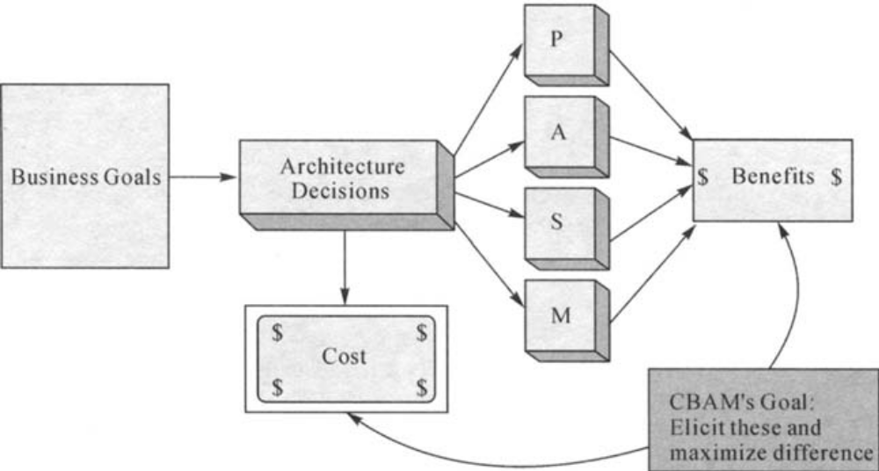
Context of CBAM

Slide 14
Prerequisites and Inputs for CBAM
Inputs in a CBAM evaluation session are:
- The business goals presentation.
- The architectural decisions and possible tradeoffs resulted in a former ATAM session.
- The quality attributes expectation level and economical constraints. (Budget)

Slide 15
CBAM Steps

Slide 16
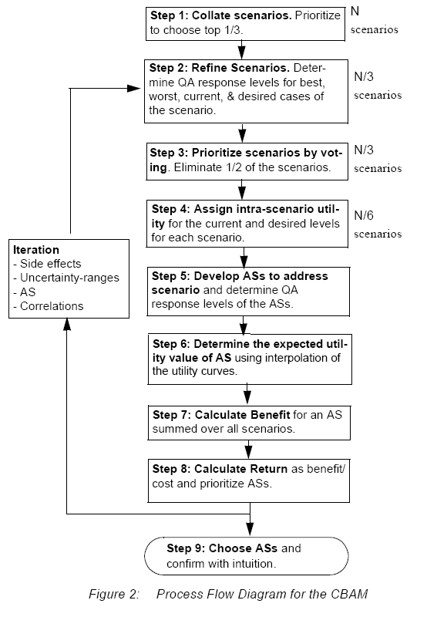

Slide 17
CBAM Outcomes and Strengths
The method provides values as a basis for a rational decision making process in applying certain architectural strategies
The method provides a business measure that can determine the level of return on investment of a particular change to the system.
The method will help organizations in analyzing and pre-evaluating the resource investment in different directions by adopting those architectural strategies that are maximizing the gains and minimize the risks.

Slide 18
Agenda
Software architecture evaluation definition.
Benefits of Architecture Evaluation.
Types of Architecture Evaluation.
Software Architecture Evaluation Methods.
CBAM, Cost Benefit Analysis Method.
CBAM, Case Study.
ATAM, Architecture Trade-off Analysis Method.
ATAM, Case Study.

Slide 19
Case Study: The NASA ECS Project
The Earth Observing System is a constellation of NASA satellites that gathers data about the Earth for the U.S.
The Earth Core System (ECS) collects data from various satellite downlink stations for further processing.
The mission of the ECS is to process the data into higher-form information and make it available in searchable form to scientists around the world.
The goals are to provide a common way to store and process data and to provide a public mechanism for introducing the new data formats and processing algorithms needed, thus making the information widely available to the scientific community at large.
The long-term nature of the project also makes modifiability an important requirement.

Slide 20
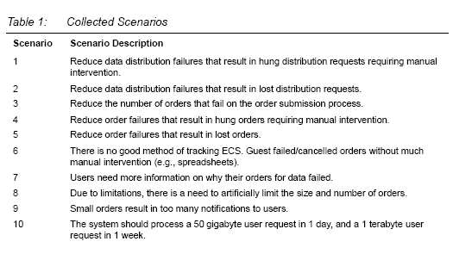
Step 1: Collate Scenarios

Slide 21
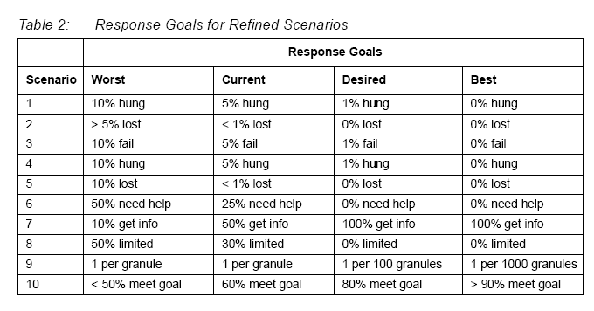
Step 2: Refine Scenarios

Slide 22
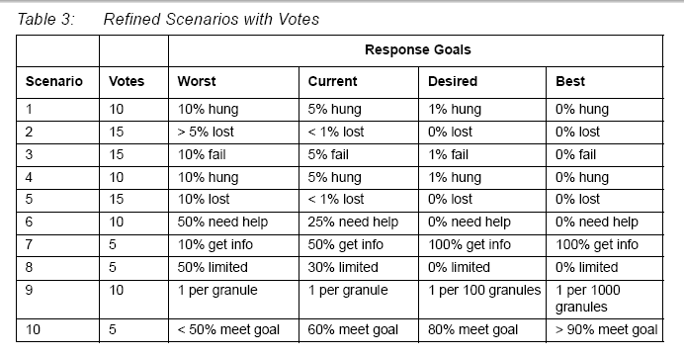
Step 3: Prioritize Scenarios

Slide 23
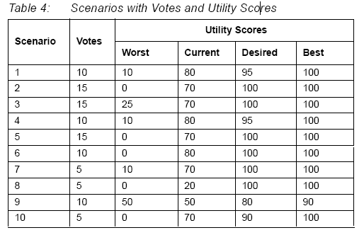
Step 4: Assign Utility

Slide 24
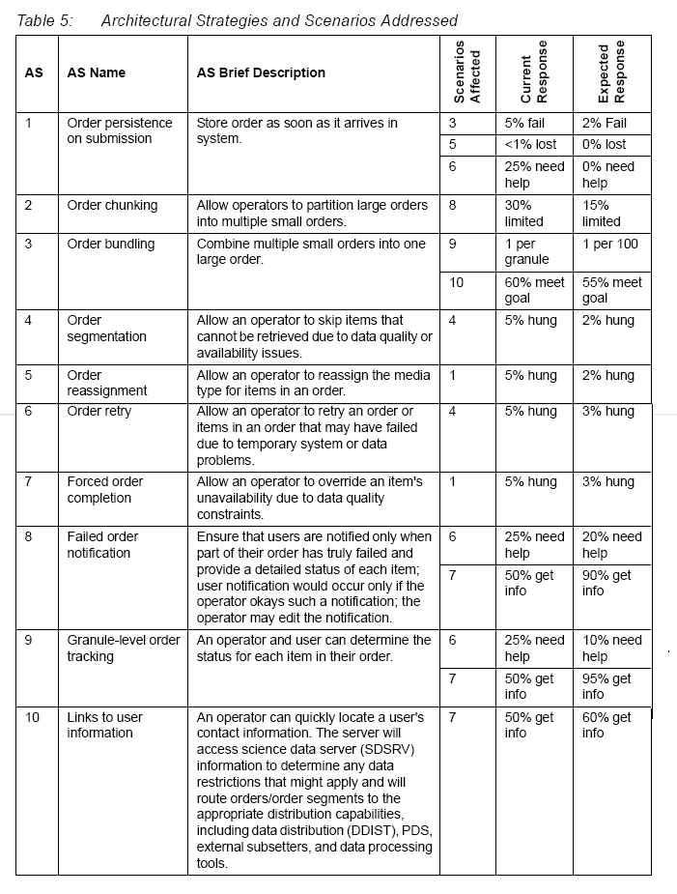
Step 5: Develop ASs for Scenarios and Determine Their Expected Response Levels

Slide 25
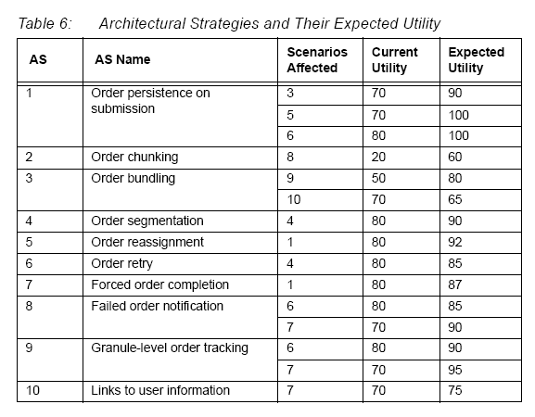
Step 6: Determine Expected Utility Levels by Interpolation

Slide 26
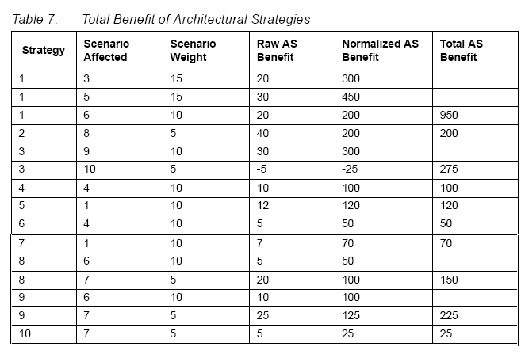
Step 7: Calculate the Total Benefit Obtained from an AS

Slide 27
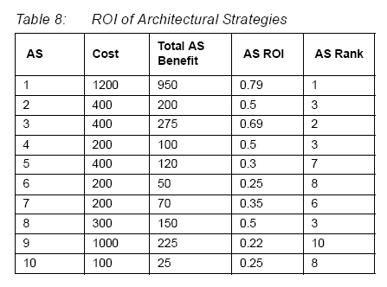
Step 8: Choose ASs Based on ROI Subject to Cost Constraints

Slide 28
Agenda
Software architecture evaluation definition.
Benefits of Architecture Evaluation.
Types of Architecture Evaluation.
Software Architecture Evaluation Methods.
CBAM, Cost Benefit Analysis Method.
CBAM, Case Study.
ATAM, Architecture Trade-off Analysis Method.
ATAM, Case Study.

Slide 29
Architecture Trade-off Analysis Method (ATAM)
ATAM is a scenario-based architecture method for assessing quality attributes such as: modifiability, portability, Variability, and Functionality
ATAM analyses how well software architecture satisfies particular quality goals. It also provides insight into quality attribute interdependencies meaning how they trade-off against each other.
ATAM is based on Software Architecture Analysis Method (SAAM).

Slide 30
Prerequisites and Inputs for ATAM
Prerequisites:
The evaluators must understand the system architecture, recognize the architectural parameters, define their implications with respect to the system quality attributes.
Problem areas were so called “sensitivity points”, “tradeoff points” and risks. These must be carefully identified.
ATAM is a context-based evaluation method in which quality attributes of the system must be understood. This can be achieved employing descriptive scenarios for evaluating the quality attributes.
Inputs:
The initial requirements of the system.
The software architecture description of the system.

Slide 31
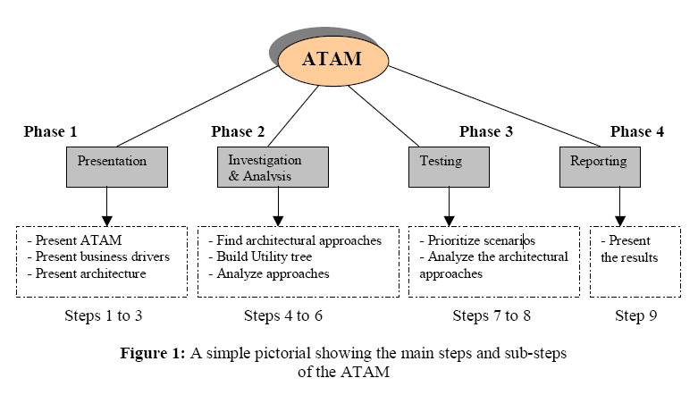
ATAM Phases

Slide 32
ATAM Outcomes and Strengths
The general strengths of an ATAM session are:
Stakeholders understand more clearly the architecture.
Improved software architecture documentation.
Enhanced communication among the stakeholders.
In terms of practical outcome ATAM delivers:
Quality scenarios produced by stakeholders based on the quality attributes requirements.

Slide 33
Agenda
Software architecture evaluation definition.
Benefits of Architecture Evaluation.
Types of Architecture Evaluation.
Software Architecture Evaluation Methods.
CBAM, Cost Benefit Analysis Method.
CBAM, Case Study.
ATAM, Architecture Trade-off Analysis Method.
ATAM, Case Study.

Slide 34
Evaluation of the Hoover's architecture using ATAM
Hoover’s Architecture is an Event Architecture that provides “Event Services” that then utilized in an event-driven application component in a system.
Phase 1: Presentation
Step 1: Present the ATAM
general info. About ATAM, analysis Techniques and expected values
Step 2: Present the business drivers
provides info. the main function of the sys., and the major stakeholders (the end user, the architect and the app. developer)
Step 3: Present the architecture to be evaluated

Slide 35
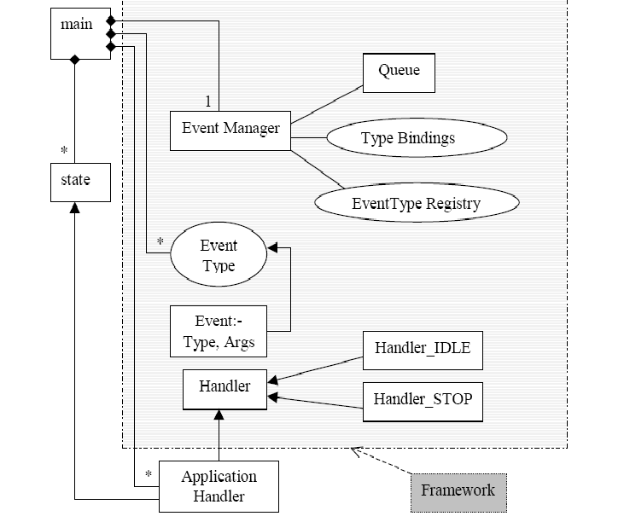
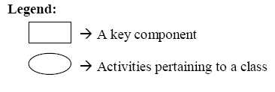
Hoover’s Architecture

Slide 36
Hoover’s Architecture Evaluation (cont.)
Phase 2: Investigation and Analysis
Step 1: Identify the architectural approaches
the architectural team explains the flow of control of the architecture and provides a proper explanation of how and whether the critical goal is met.
* Modifiability, Functionality, Variability, and Reliability
Step 2: Generate the quality Attribute Utility tree
the system’s most important quality attribute goals are identified, prioritized and refined.
Stage 1: Scenario Generation
Stage 2: Utility Tree Generation

Slide 37
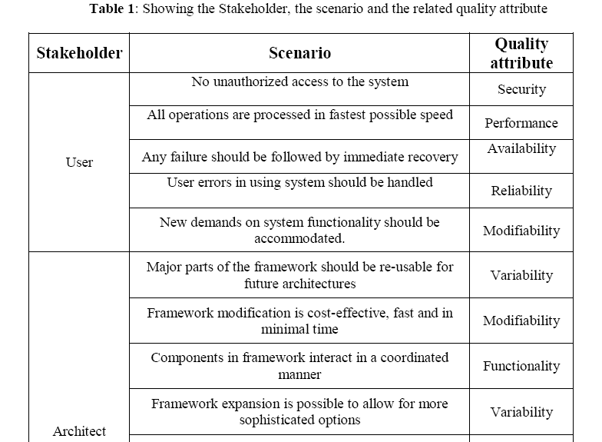
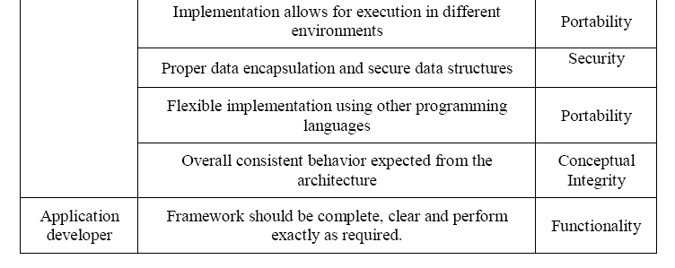
Phase 2 Step 2 Stage 1: Scenario Generation

Slide 38
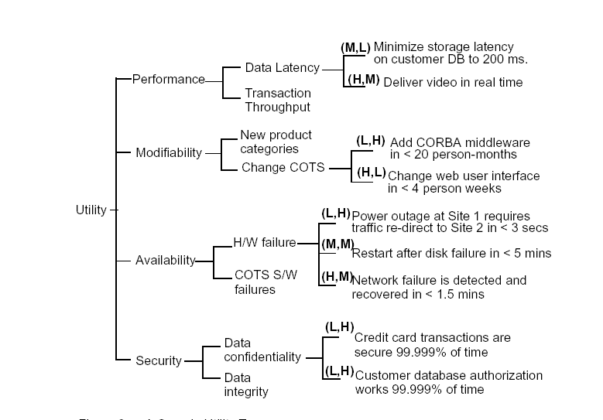
Phase 2 Step 2 Stage 2
Generate the quality Attribute Utility tree

Slide 39
Phase 2 Step 3
Step 3: Analyze the Architectural Approaches
Identify the quality attributes that have the high degree of prioritization. (Variability, Reliability, Conceptual integrity, Functionality and Modifiability)
Stage 1: Investigation of architectural approach
determine how the architecture support these quality attributes
Stage 2: Creation of analysis questions
Stage 3: Answers to the analysis Questions
Stage 4: Find the risks, non-risks, sensitivity points and trade-off points

Slide 40
Phase 2 Step 3 Stage 2
Creation of analysis questions
Can the components of the architecture reused for future projects? (variability)
Will the system handle any input given by the user and handle invalid input? (reliability)
Is the architecture consistent in behavior? (conceptual integrity)
Can any new application-specific functionality be added to the architecture? (modifiability)
Do the components interact properly? (functionality)

Slide 41
Phase 2 Step 3 Stage 3
Answers to the analysis Questions
Does the system handle any input given by the user and handle invalid input?
Although the flawed input is identified at a later stage, the system handles all the input given by the user and handles any invalid input.
Do the components interact properly?
The components in this architecture interact in a well defined manner.

Slide 42
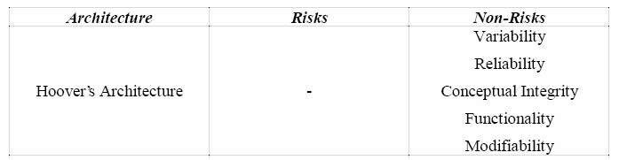
Phase 2 Step 3 Stage 4
Find the risks, non-risks, sensitivity points and trade-off points
Sensitivity Points
The handling of incorrect input is sensitive to number of event types in the application
Trade-off points
Modifiability and Reliability vs Performance

Slide 43
Hoover’s Architecture Evaluation (cont.)
Phase 3: Testing
Step 1: Brainstorm and Prioritize Scenarios
prioritized the scenarios with according to all stakeholders
(tables)
Step 2: Analyze the architectural approaches
the same as in Phase 2 Step 3 but in more for the higher voted quality attributes

Slide 44
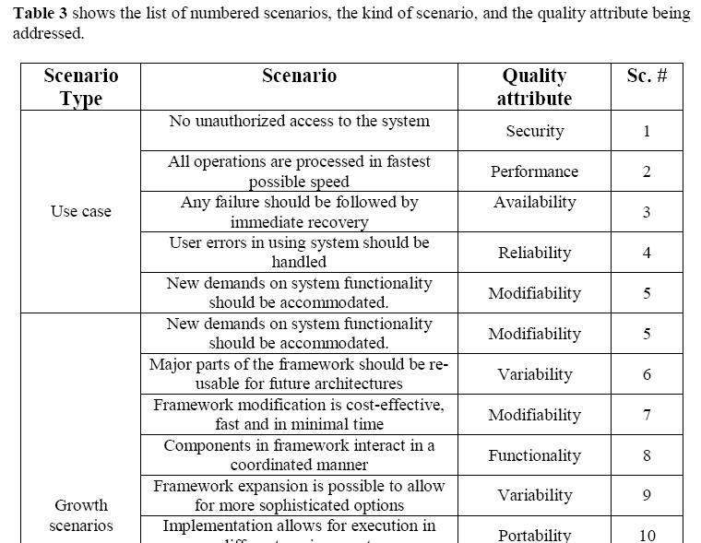
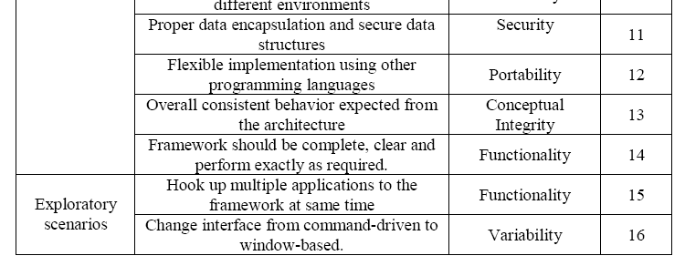
Phase 3 Step 1 Brainstorm and Prioritize Scenarios
User Scenarios
Architecture’s growths
Extreme growths

Slide 45
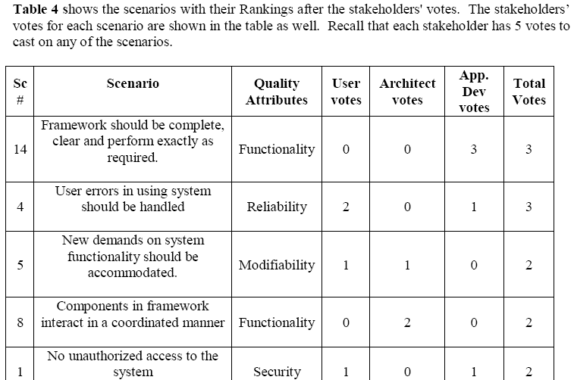
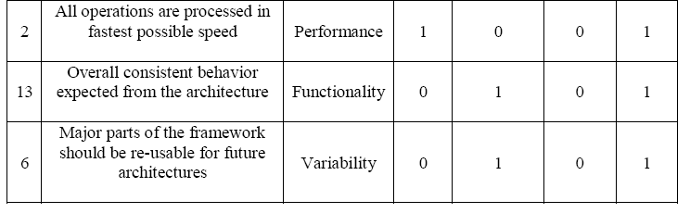
Phase 3 Step 1
Brainstorm and Prioritize Scenarios
Merge the scenarios with the same QA.
Each stakeholder has 5 votes to cast on any scenario of their choice
Number of votes = 30%* # Sc.
=.3*16=5

Slide 46
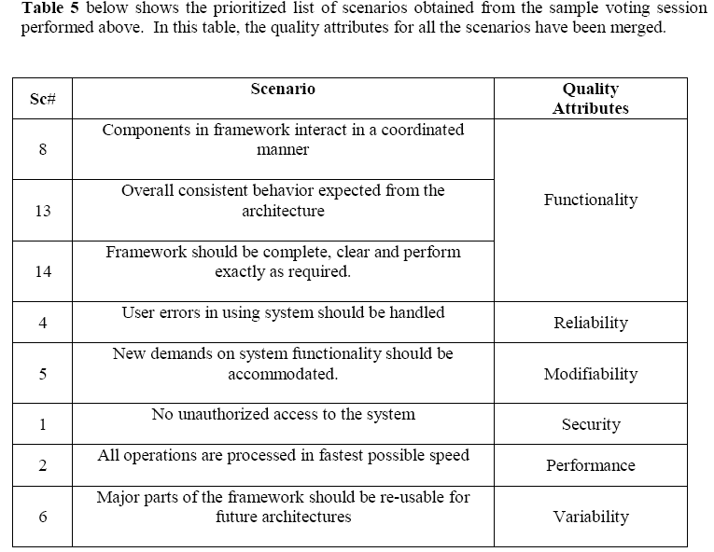
Phase 3 Step 1
Brainstorm and Prioritize Scenarios
The scenarios are ordered by the vote total

Slide 47
Hoover’s Architecture Evaluation (cont.)
Phase 4: Report the ATAM
The ATAM team presents their findings to the group of stakeholders. The main findings of the ATAM team usually include:
- A utility tree
- Set of generated scenarios
- Set of analysis questions
- Set of identified risks and non-risks
- The identified architectural approaches

Slide 48
Summary
Software Architecture Evaluation Methods.
ATAM, CBAM, SAAM, ALMA, FAAM.
CBAM, Cost Benefit Analysis Method.
CBAM an architecture-centric method for analyzing the costs, benefits and schedule implications of architectural decisions.
ATAM, Architecture Trade-off Analysis.
ATAM an architecture method evaluation for analyzing the quality attributes of the system.

Slide 49
Questions??

